Slide 1


Python programming
How to set up Python

Slide 2
Tl;dr
Quick version - Installing Python
It’s free. Visit www.python.org
Be sure to check Add Python 3.7 to PATH
Install a programming editor, e.g. atom.io
Open the Windows CMD prompt (or shell on Mac or Linux)
Type - python
Notes:
2

Slide 3
Step by step
How to install and start using Python
Do you have permission?
These instruction assume you have permission to install software on a computer. By this I mean that you are allowed to, and that you have the necessary computer security rights, for example you have “administrator” rights.
Notes:
3

Slide 4
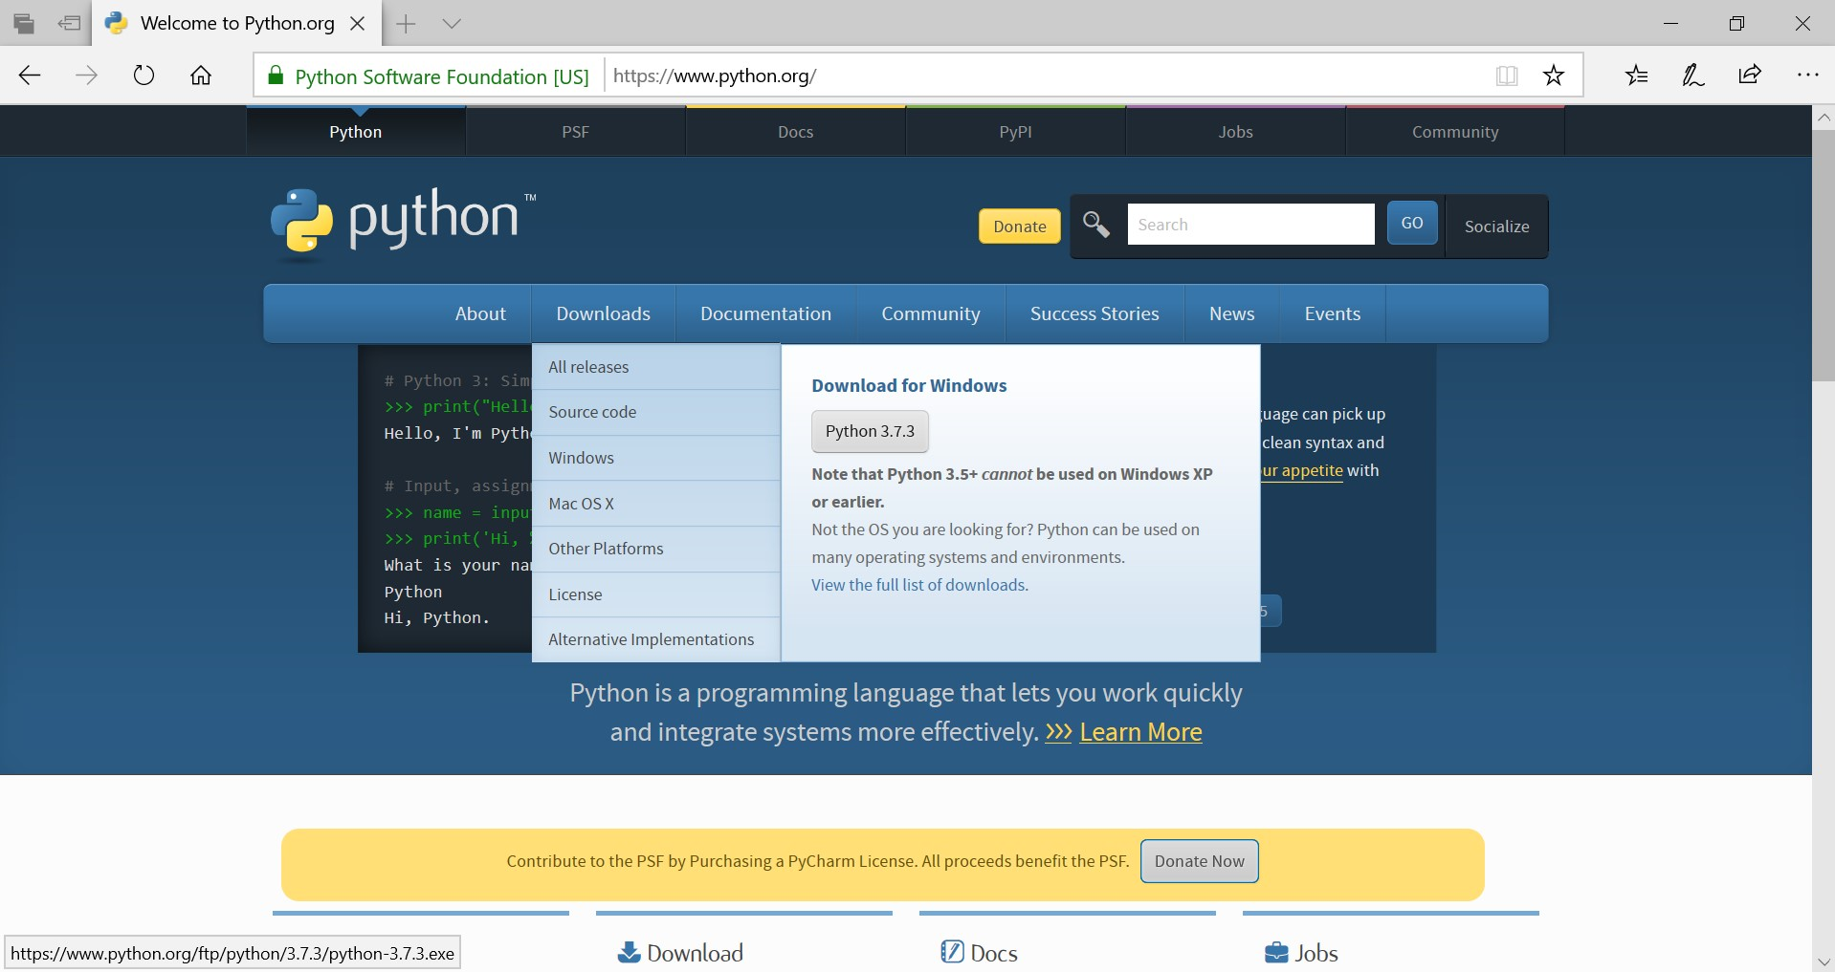
Step 1 – Download Python
Visit www.python.org
Notes:
4

Slide 5
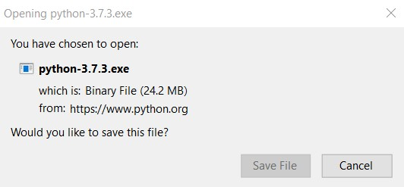
Step 2 – Download Python
Save the file (note version numbers change)
Notes:
5

Slide 6
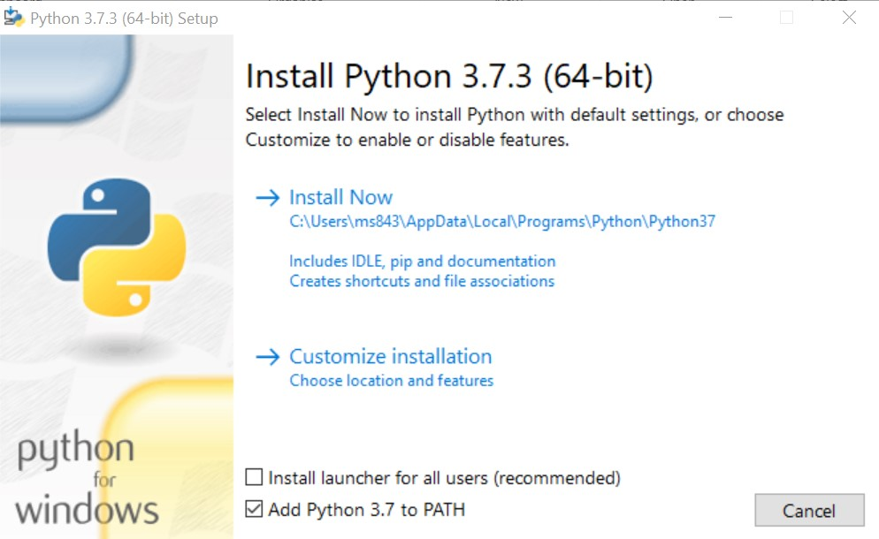
Step 3 – Install Python
Check - Add Python 3.7 to PATH
Click on – Install Now
Notes:
6

Slide 7
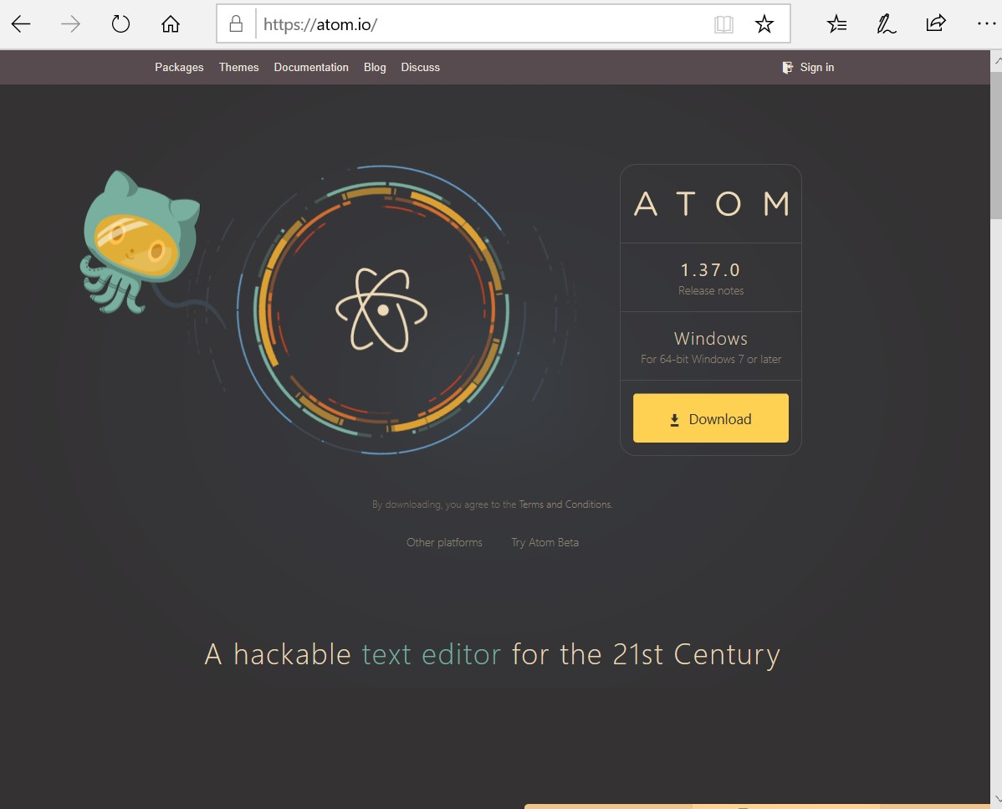
Step 4 – Download Atom Editor
Visit atom.io
Notes:
7

Slide 8

Step 5 – Install Atom
Notes:
8

Slide 9
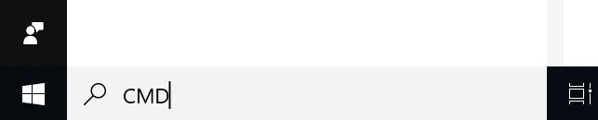
Step 6 Open the CMD Prompt
On Windows computers. Mac is different.
Notes:
9

Slide 10
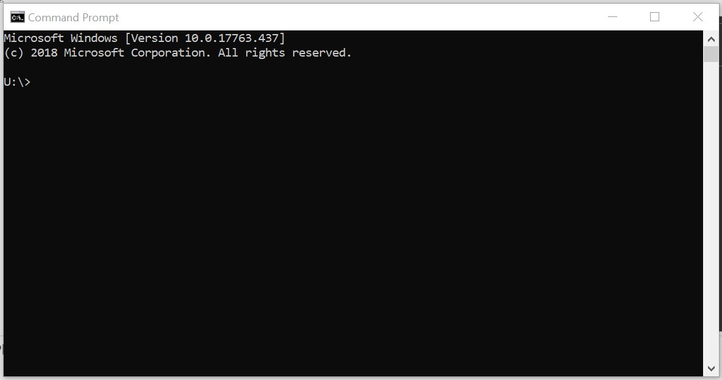
Step 7 Practice using “the shell”
Also called the “terminal”, or
“command prompt”
Notes:
10

Slide 11
Step 8
Run Python in “interactive mode”
U:\>python
Python 3.7.3 (v3.7.3:ef4ec6ed12, Mar 25 2019, 22:22:05) [MSC v.1916 64 bit (AMD64)] on win32
Type "help", "copyright", "credits" or "license" for more information.
>>> help()
Welcome to Python 3.7's help utility!
If this is your first time using Python, you should definitely check out
the tutorial on the Internet at https://docs.python.org/3.7/tutorial/.
Notes:
11

Slide 12
Step 9
Quit Python
U:\>python
Python 3.7.3 (v3.7.3:ef4ec6ed12, Mar 25 2019, 22:22:05) [MSC v.1916 64 bit (AMD64)] on win32
Type "help", "copyright", "credits" or "license" for more information.
>>> quit()
U:\>
Notes:
12

Slide 13
Step 10
Launch Atom
U:\>mkdir mypython
U:\>atom mypython
U:\>
Notes:
13

Slide 14
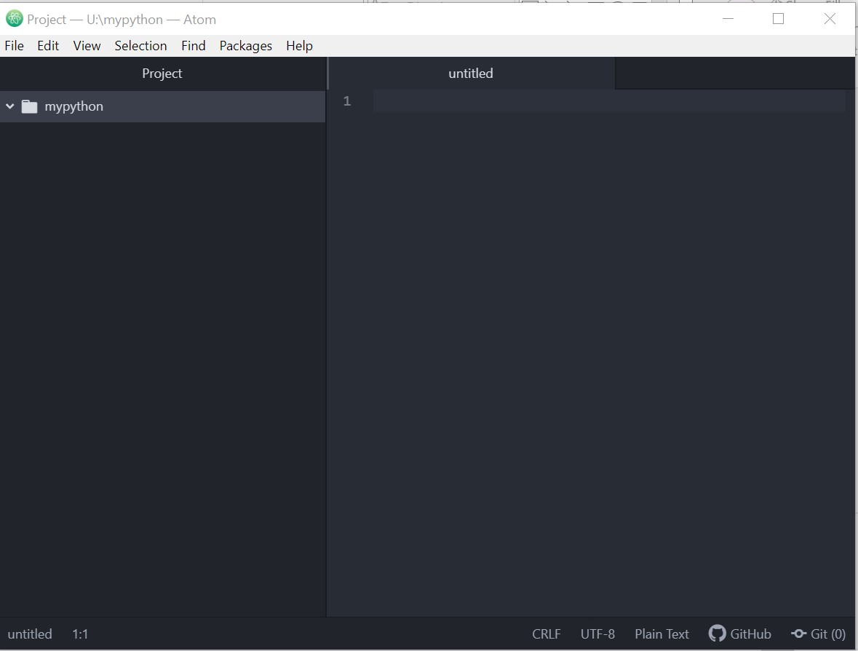
Write your first Python script
Notes:
14

Slide 15
EXTRAS
Running Python programs in Atom
This is optional
In CMD prompt type
python -m pip install python-language-server[all]
Notes:
15

